Slide 1
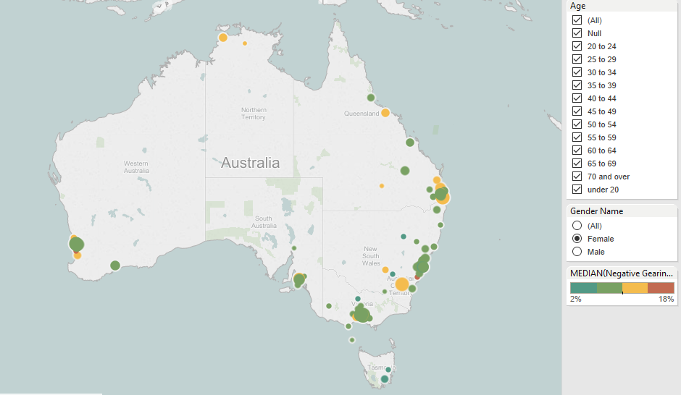
Females

Slide 2
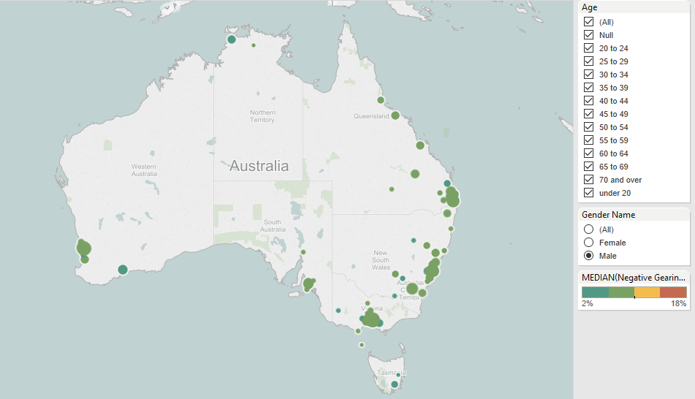
Males

Slide 3
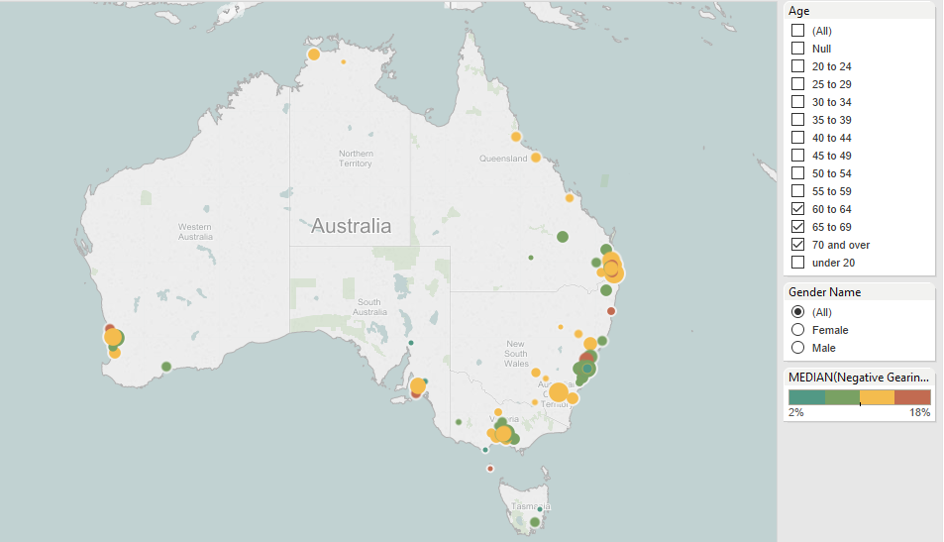
Over 60

Slide 4

Under 30s

Slide 5
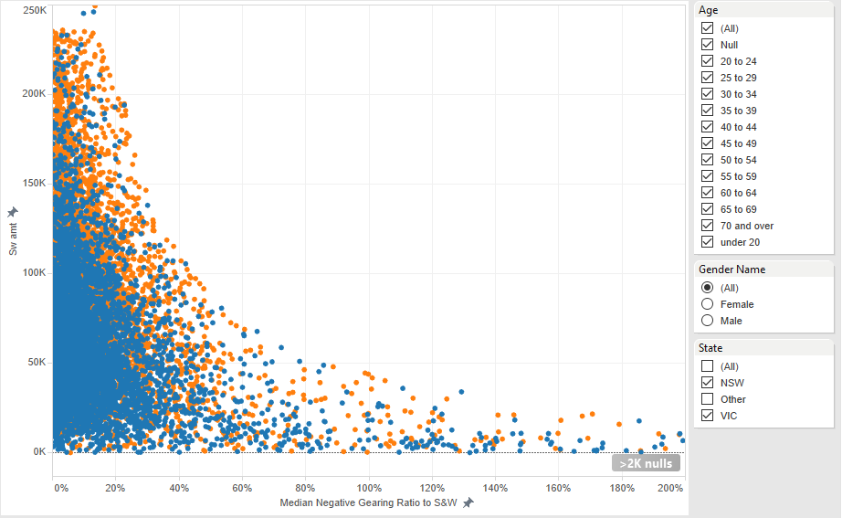
Blue = Female Orange = Male

